Slide 1
Multivariate AQ estimation
Employed meteorological data, ground feature data from OSM dataset, etc to estimate PM2.5 and PM10 values.
Totally explain 70% variances (EV), 20% from the ground feature and satellite images, 50% from meteorological effect.
There are city-level fixed effect that cannot be explained by land-use and meteorological data.
Estimated seasonal stationary data as the target variable.
Feature selection, back-propagation, ensembling, etc.
Deploy to aws metaflow with data in s3 bucket.

Slide 2
Image feature semi-supervised learning
From computer vision methodologies, weakly label several images with pores. (recall:, precision:)
Train yolov8 on it and deal with noises. Correct labels.
Continue this process and train a yolo finally on all the data.
Achieved an MAP of …, more robust than professional software, which is based on 2 sets of test data.

Slide 3
Auto-label correction
From the yolov8 works well on small set of data, although with noises. Just better performance than DETR.

Slide 4
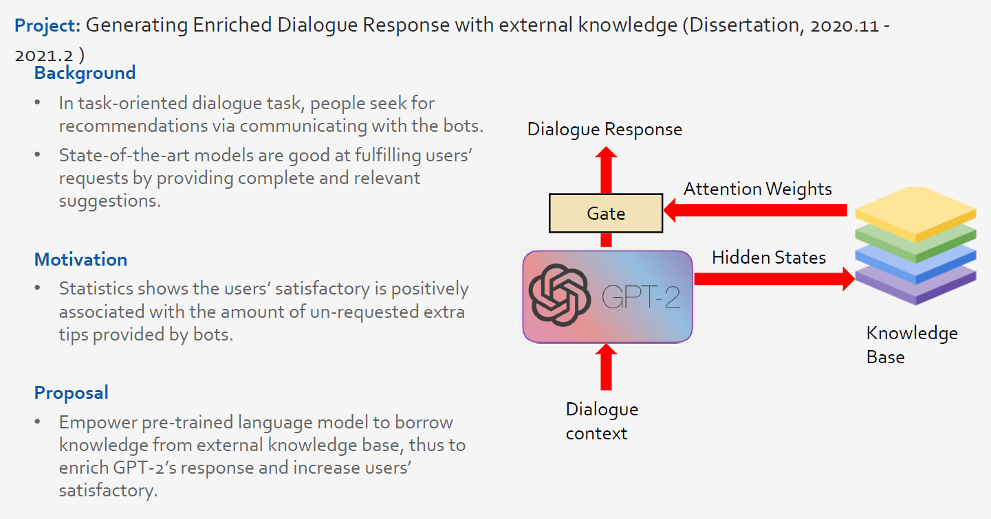

Slide 5
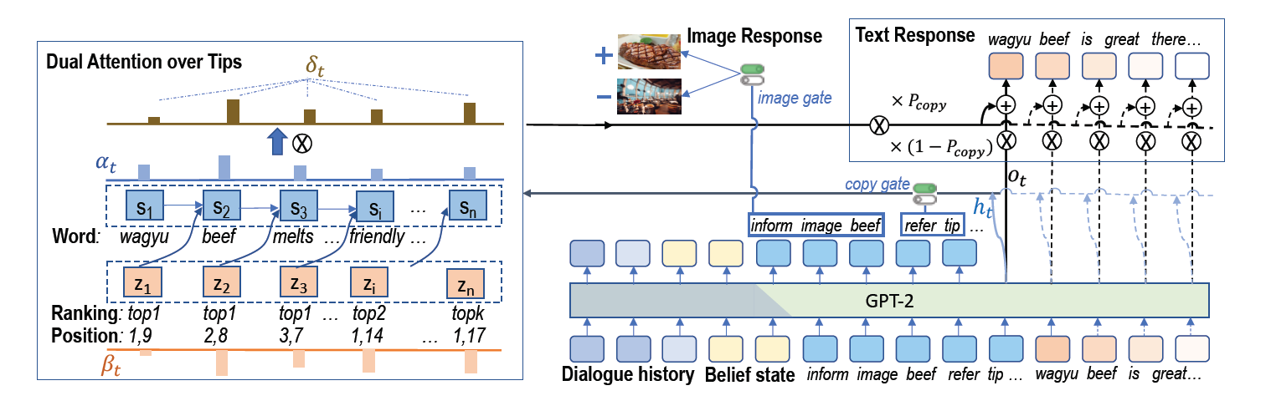
1 GPU V100, GPT-2 117M 10k+ entries of training data. 3 hours

Slide 6
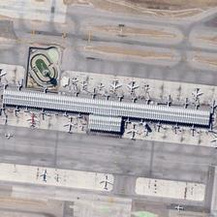
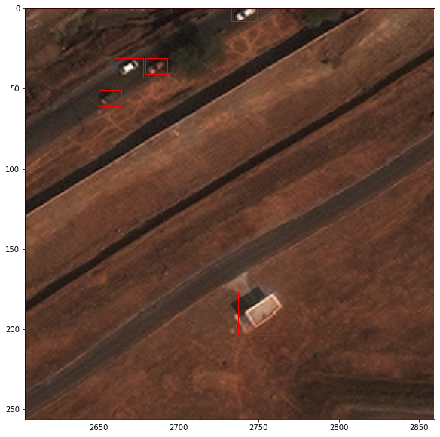
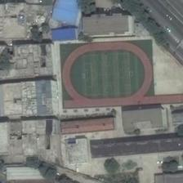
Image Captioning Dataset
Evaluation: RSICD image captioning dataset
ChatGPT verification: manual labelled 100+ images
"Many aircraft are parked next to a long building in an airport."
Three small cars are clustered together in the top left corner of an aerial image.
A building stands alone in the center bottom of an aerial image
“a playground surrounded by many buildings is near to a road”

Slide 7
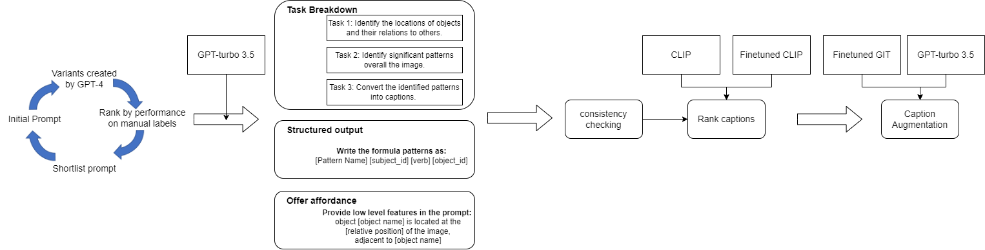
Data Collection Process
Prompt selection
Prompting
Verification
Augmentation
Similarity between GPT captions and manual labels (CIDEr)
63.67
90.09

Slide 8
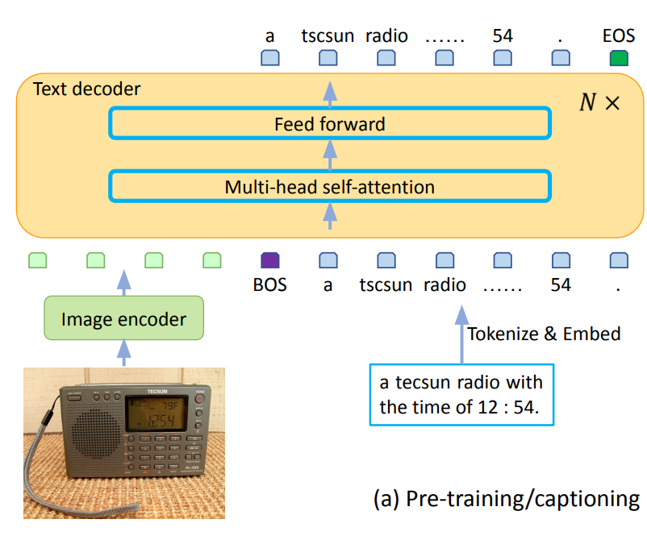
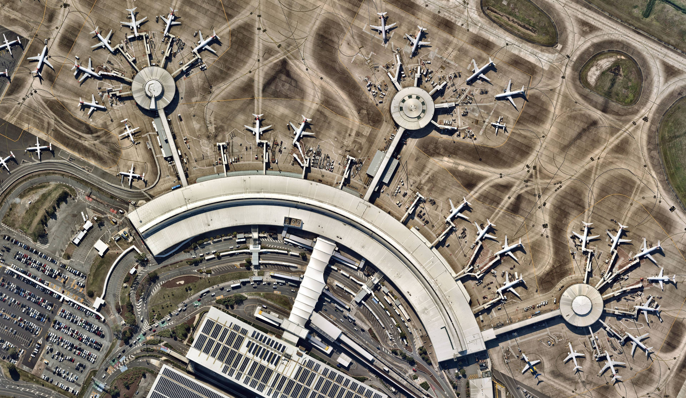
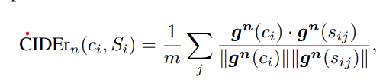

8k entries of data generated. 20 times per image. 1k tokens per query.
Finetune GIT model: 129M parameters, 1 A100 GPU, 1 hour
CIDEr: 85.91
many aircraft are parked near a large building in an airport.
N = 4

Slide 9
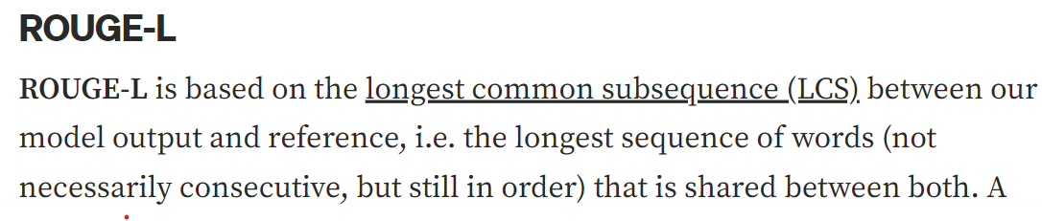
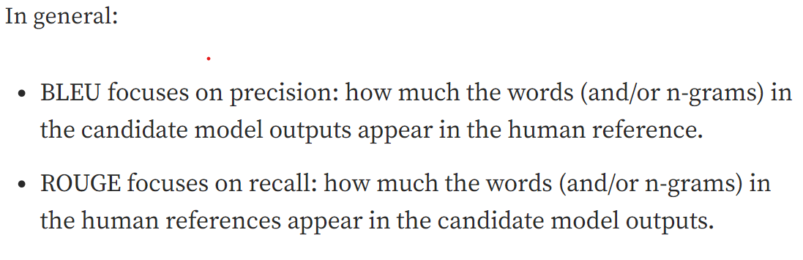
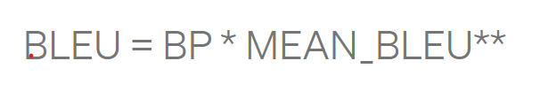
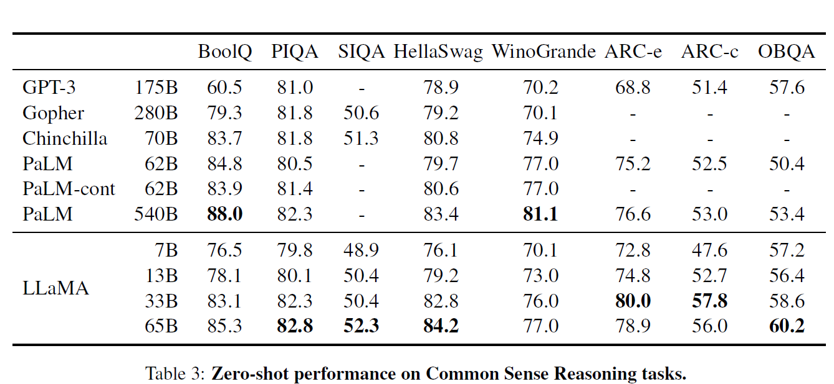
Evaluation metrics: why use CIDER, what is BLEU, Rouge, WER, etc. only for less open ended questions.

Slide 10
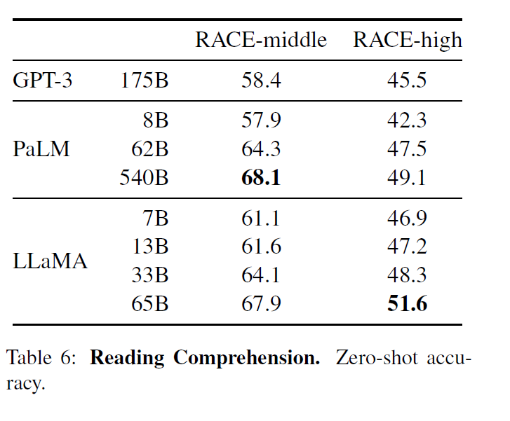
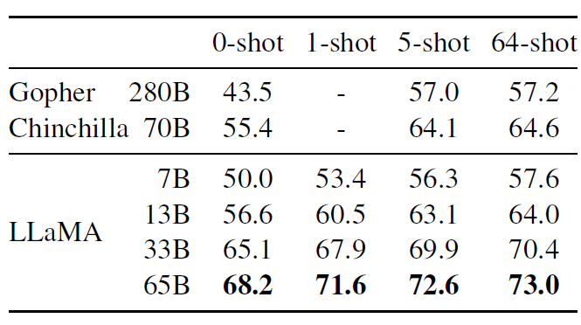
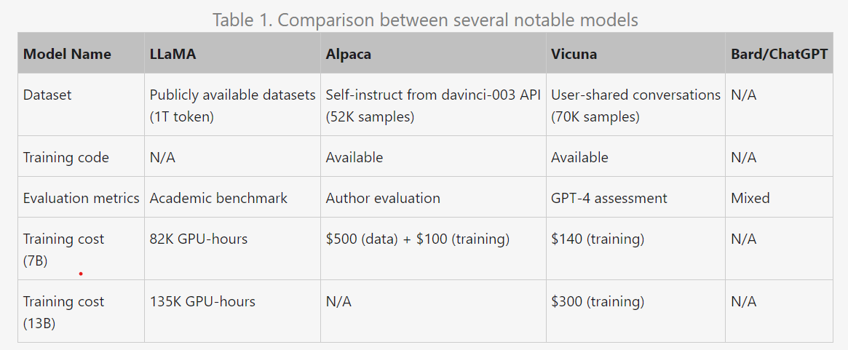
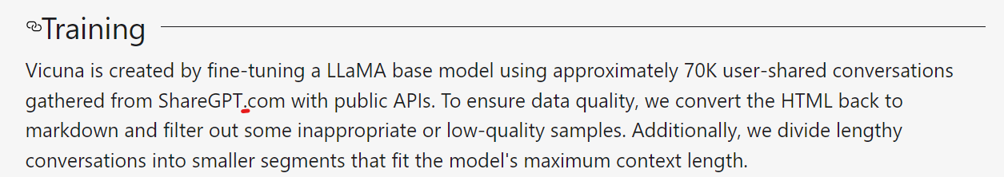
3hrs with batch size=32

Slide 11
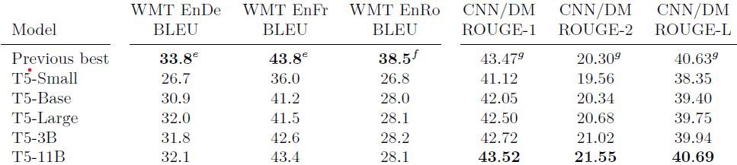
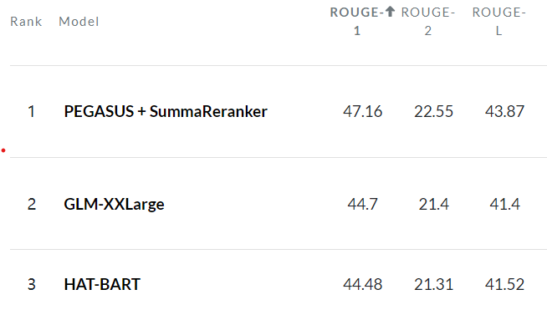
60M
220M
770M

Slide 12
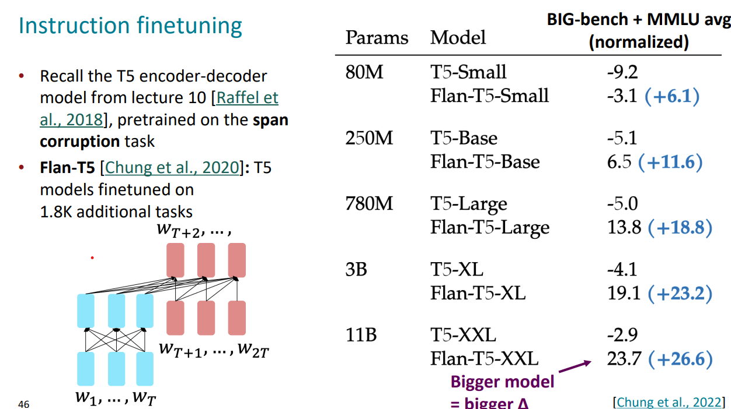

Slide 13
